Slide 2
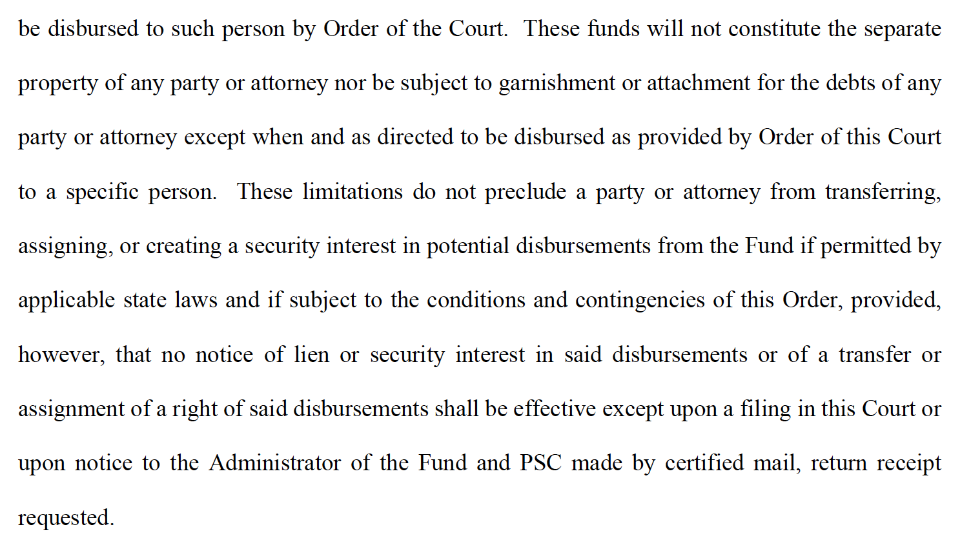
Avandia Administrator

Slide 3
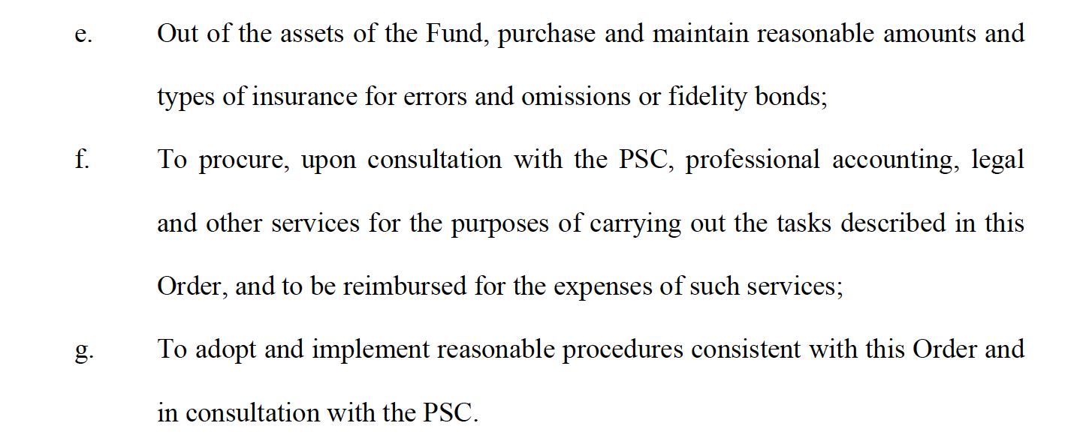
Avandia Funding

Slide 4
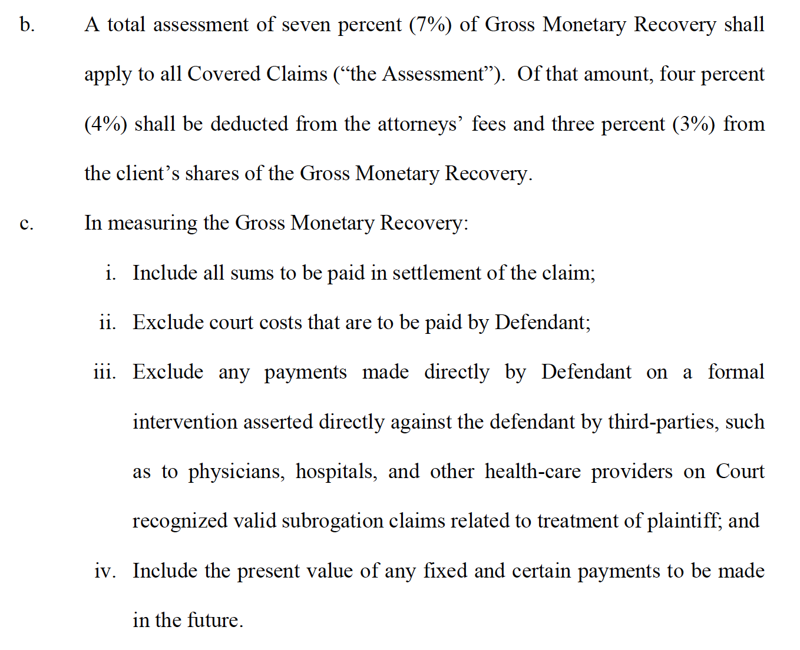
Avandia Assessments

Slide 5
Avandia Distribution

Slide 7
Abilify Special Master

Slide 8
Abilify Assessments

Slide 9
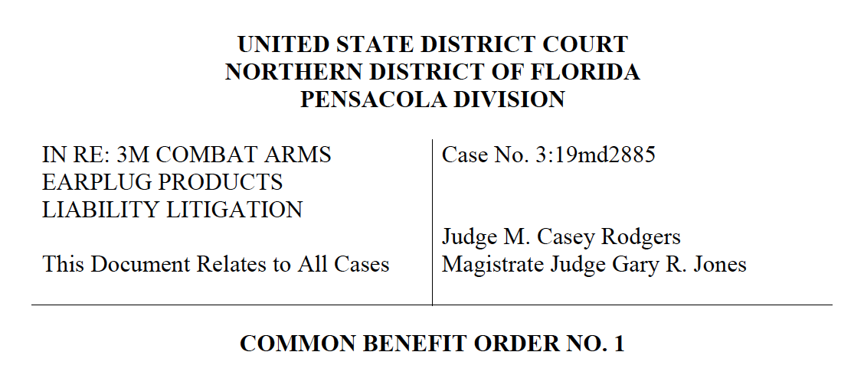

Slide 10
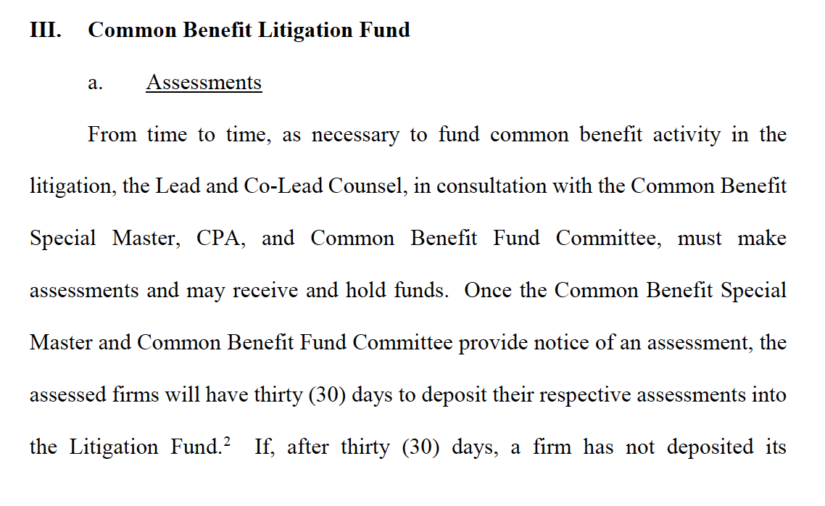
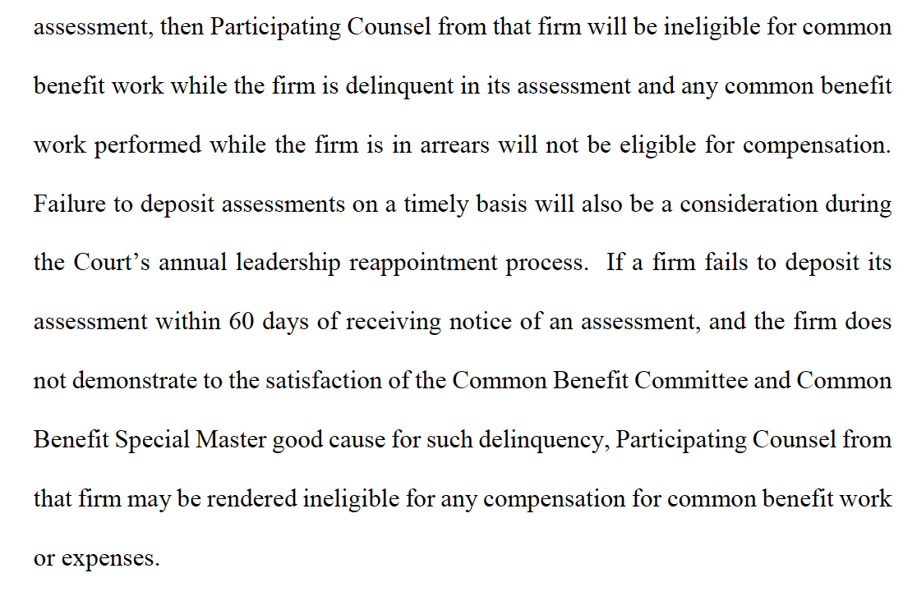
3M Assessments

Slide 11
3M Litigation Fund Payments

Slide 12
3M Litigation Fund Payments

Slide 13
3M Litigation Fund Payments

Slide 14
3M Authorization for Common Benefit Work

Slide 15
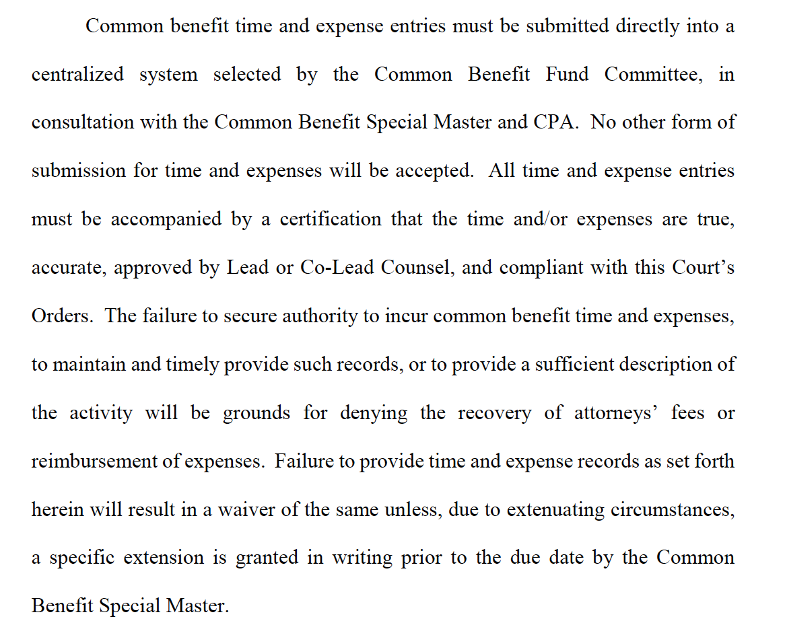
3M Time & Expense Submission

