Slide 1
Privacy, Data Protection & Security
Getting Started in Privacy
October 4, 2017

Slide 2
Agenda
Introductions
Overview: Privacy, Data Protection and Security Law
Role of Privacy Lawyers:
In –House
Law Firms
Government
Favorite Things about Being a Privacy Lawyer
Suggestions for Steps to Take to Prepare to Be a Privacy Lawyer

Slide 3
Introductions
Debra Bromson—Assistant General Counsel, AAA Club Alliance Inc.
Margaret Gloeckle—VP, Privacy & Compliance Counsel A & E Networks
Laura Schmidt—Associate, White & Williams
Ashley Slavik-Senior Counsel & Global Data Privacy Officer, Veeva Systems
Neil Chilson-Acting Chief Technologist, Federal Trade Commission

Slide 4
Overview
Privacy and Security concerns have reached new levels due to:
The proliferation of the Internet of Things, and new technologies that allow the collection of personal data
Online marketing/Behavioral Advertising/Mobile Apps
Significant Global Laws requiring compliance and requirements for protecting and sharing personal data across borders
Big Data/Data Analytics
Huge increase in Data Breaches
Large growth in litigation
Cybersecurity requirements

Slide 5
U.S. Privacy Framework
No single comprehensive federal law—different laws (sectoral) based on industries such as:
Financial Privacy (e.g. GLBA)
Educational Privacy
Health Privacy (HIPAA)
Section 5 of FTC Act prohibiting deceptive and unfair practices
State laws
Data Breach Notification—48 states, DC and most territories
State financial privacy laws ( e.g. NYS; other states have incorporated PCI DSS into laws)
California Online Privacy Protection Act (COPPA) and Delaware Online Privacy and Protection Act (DOPPA)
Health Privacy Laws

Slide 6
U.S. Privacy Framework
Voluntary standards
Company Privacy Policy (may be enforced by FTC)
Payment Card Industry Data Security Standards (PCI-DSS)
Digital Advertising Alliance

Slide 7
Global Privacy
Broad scope of laws—Need to understand and determine obligations for an organization based on where they conduct business or collect personal data
EU—General Data Protection Regulation becoming effective May 25, 2018.
GDPR provides for a strict new framework with increased obligations for organizations
Reach is global (referred to as extra-territorial scope)—impacts organizations from any country that offers goods or services (irrespective of whether payment is required) to or monitors behavior of individuals in the EU
Asia
Canada
South America—Brazil as the “lead” country
Need to recognize differences between jurisdictions
Prepare for mandatory breach notifications

Slide 8
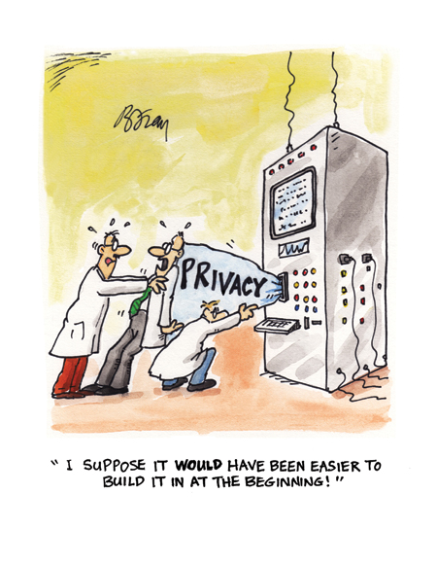
Key Operational Privacy Steps
Cross Border Privacy Compliance—Privacy Shield, model contracts, vendor requirements
Privacy by Design—Proactive planning
Privacy Impact Assessments
Data Mapping— “Who, What, Where, When, Why and How” you collect,
share and process personal data
Vendor Management
Privacy Policy requirements
Best practices—consent, transparency
Data Breach Program
Privacy Training and Communications
Cybersecurity Insurance

Slide 9
Building a Privacy Team--Interactions with Stakeholders
Privacy Office—Chief Privacy Officer
Information Technology—CIO; CISO
Legal –In-house; Outside Counsel
HR
External and Internal Communications
Outside Consultants

Slide 10
Privacy Lawyer-- In-House
Many ways companies may structure privacy support:
Privacy Office—Can report to GC; Compliance or IT
Data Protection Officer-- as may be required under GDPR
Legal Department
Bigger companies usually have lawyers who support the Privacy Office
Smaller companies may just have a lawyer who acts as a privacy officer or advisor
Other business areas that will likely need privacy input from legal: M & A, Contracting and Procurement, Marketing, E-Commerce, HR (eg health plans)

Slide 11
Privacy Lawyers in Law Firms
Practice can span litigation, transactional and compliance work
Can serve as outside privacy/security counsel for small to mid-size companies
Frequently work with other practice areas in the firm – both internal and external marketing is important
Working with outside vendors and consultants is very common
Learning and keeping up to date on recent developments is critical and must be a daily habit

Slide 12
Privacy Lawyers in Government
Law enforcement / litigation
FTC’s Division of Privacy and Identity Protection
State AG offices
International coordination
Subject matter expertise + diplomatic skills
Compliance with government privacy requirements
Chief Privacy Officers
Similar to In-House Role

Slide 13
Favorite Things about Being a Privacy Attorney
International Scope
Area is constantly changing –Both from a technology viewpoint and legal requirements
Impacts most areas of a business so provides the ability to work with many different colleagues
Building a Privacy Program
Customer Focus

Slide 14
Suggestions for Steps to Take to Prepare to Be A Privacy Lawyer
Take privacy classes at GW—Dan Solove is a top privacy expert!
Experience/understanding of IT and cybersecurity is very helpful
Networking/Get a Mentor
Learning—Stay up to date through newsletters, free webinars and workshops
Join the IAPP, or other industry related groups—consider getting an industry certification (eg. CIPP)
Look for positions at firms with clients whose businesses are likely to raise privacy issues, or in-house roles where you can begin to develop your expertise
Privacy Internships
PrivacyCon2018—FTC has put out a call for presentations from students for PrivacyCon Student Poster Session for PrivacyCon 2018 (February 28, 2018)-- https://www.ftc.gov/news-events/events-calendar/2018/02/privacycon-2018

Slide 15
Suggested Resources
Teach Privacy-- www.teachprivacy.com
Dan Solove’s other websites: https://www.informationprivacylaw.com/
IAPP website—www.iapp.com
Privacy Blogs: Examples:
White and Williams: http://cyber.whiteandwilliams.com/
Sidley Austin: http://datamatters.sidley.com/
Hogan Lovells: http://www.hldataprotection.com/
Hunton & Williams: https://www.huntonprivacyblog.com/
Nymity--www.nymity.com
TrustArc-www.trustarc.com
Charts on US Security Breach Laws-- See BakerHostetler; FoleyLardner; Mintz Levin; Perkins Coie; DavisWrightTremaine

